Slide 1
REDUNDANCY REDUCTION IN FACE RECOGNITION USING SSD
SECOND REVIEW
Guided By,
Mr.M.Vignesh,
Assistant Professor,
Department of Artificial Intelligence and Data Science,
Karpagam Institute of Technology,
Coimbatore.
Presented by
S.DHANUSH(721220243010)
V.KISHOR KUMAR(721220243027)
S.LINKEDH (721220243028)
S.VIMAL(721220243062)
Department of Artificial Intelligence and Data Science,
Karpagam Institute of Technology,
Coimbatore.

Slide 2
OUTLINE
Abstract
Module Description and Implementation
Module Diagrams ( DFD/ UML )
Input Parameters for Each Modules
Algorithm Explanations
References

Slide 3
ABSTRACT
The Proposed system improved Viola-Jones face detection using Single Shot Detector Algorithm in order to reduce the redundancy rates. Viola-Jones ' s algorithm has succeeded in determining the best face scale factor, but it produces a non-comparable face window that leads the redundant face detection.
Facial recognition uses Computer-generated filters to transform face images into numerical expressions that can be compared to determine their similarity.
Single Shot Detection algorithm significantly faster in speed and high-accuracy object detection algorithm. It exibits small convolutional filters to predict object classes and offsets to default boundary boxes.

Slide 4
LIST OF MODULES
The Face Detector
(Module 1)
Data Scraping
(Module 2)
The Recognizer
(Module 3)

Slide 5

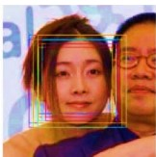
MODULE 1
THE FACE DETECTOR
Existing Method
The Existing Algorithm have the low Detection of the faces.
It also Detect the face redundantly which may cause inaccuracy in the result.

Slide 6
The Face Detector
Faces are made of thousands of fine lines and features that must be matched.
The Face Recognition using Python, break the task of identifying the face into thousands of smaller, bite-sized tasks.
The Main objective of facial recognition is to identify individuals, whether individually or collectively.

Slide 7

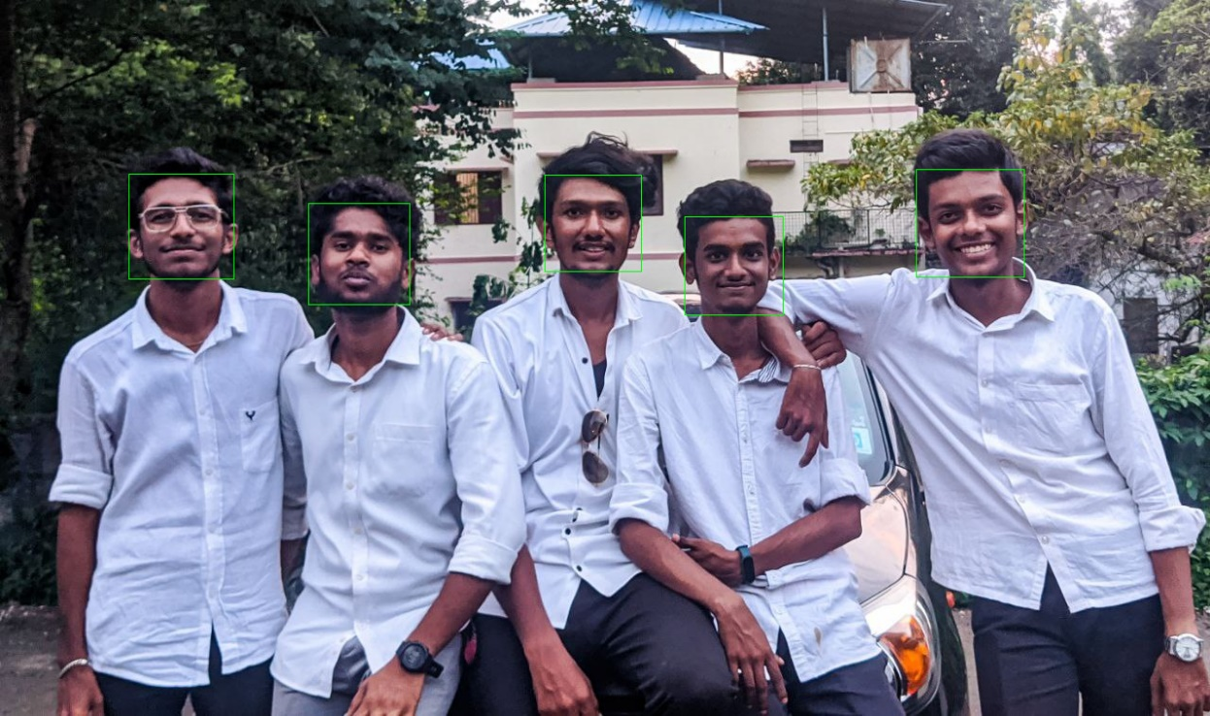
Face Detector – Implementation / Results
Input
Output

Slide 8

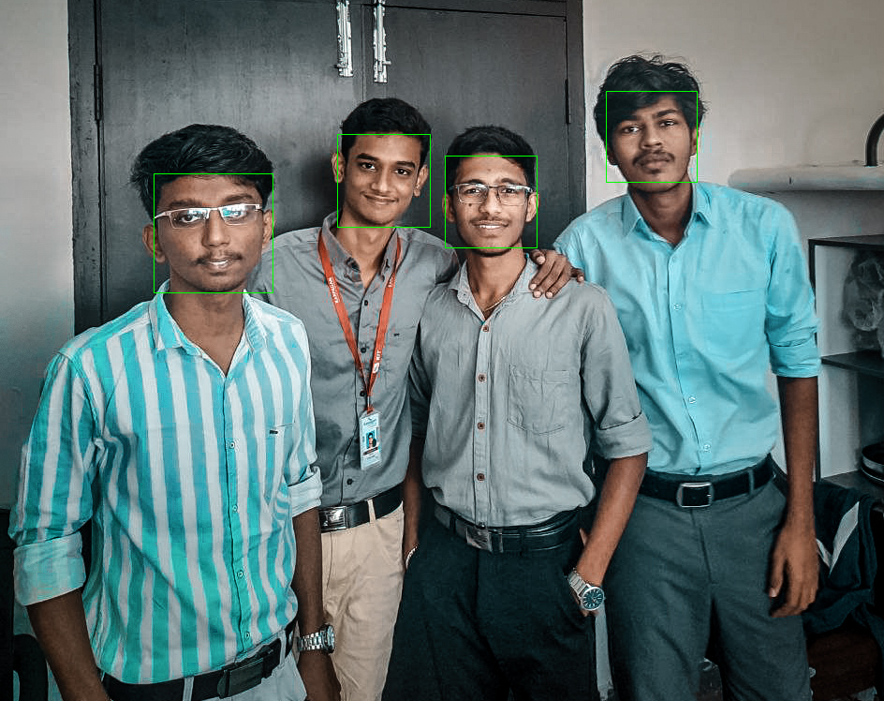
Face Detector – Implementation / Results
Input
Output

Slide 9
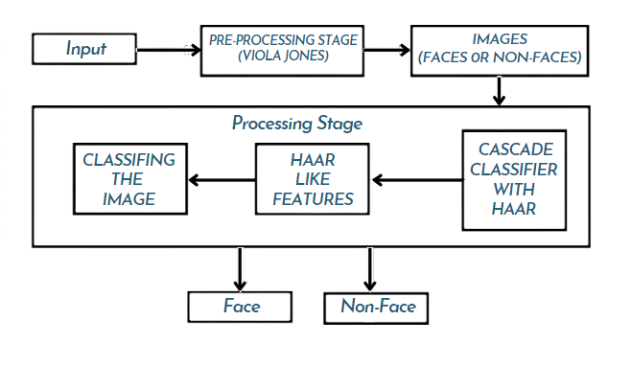
Face Detector – Data Flow Diagram

Slide 10


Face Detector – Screen Shots

Slide 11
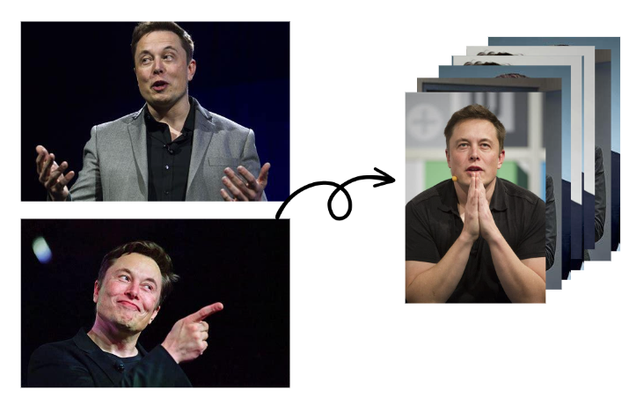
MODULE 2
DATA SCRAPING

Slide 12
Data Scraping
Data collection for facial recognition falls under image data collection and involves gathering face images to train.
Face images are taken of different people, annotated, and then fed into a machine learning model, which uses them to learn how to scan, identify and process facial features.
Data scraping involves pulling information out of a website.
It's completely legal to scrape publicly available data.

Slide 13

Data Scraping – Implementation / Results

Slide 14
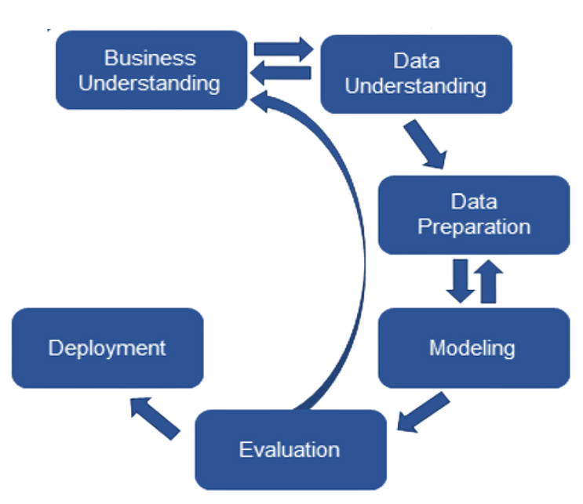
Data Scraping - Data Flow Diagram

Slide 15

Data Scraping - Screen Shots

Slide 16
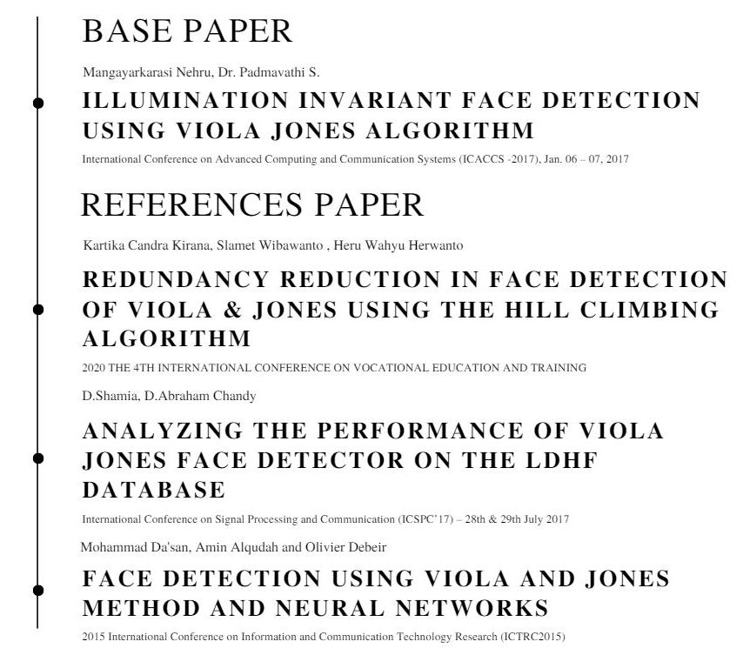
REFERENCES

Slide 17
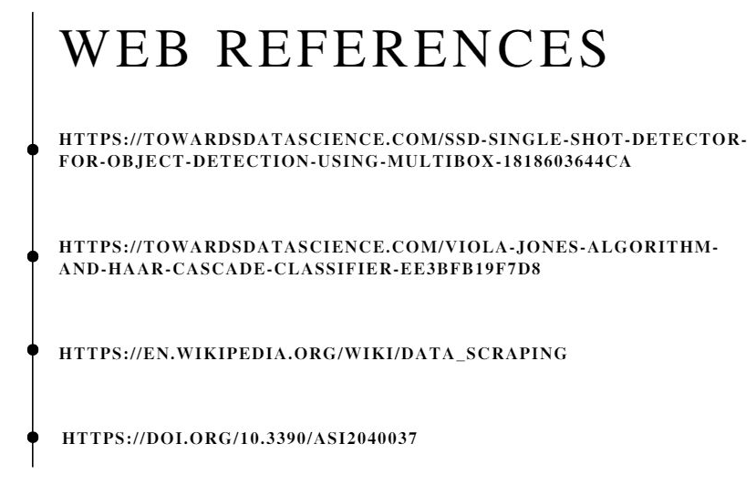
REFERENCES

Slide 18
Thank You!

